Slide 1
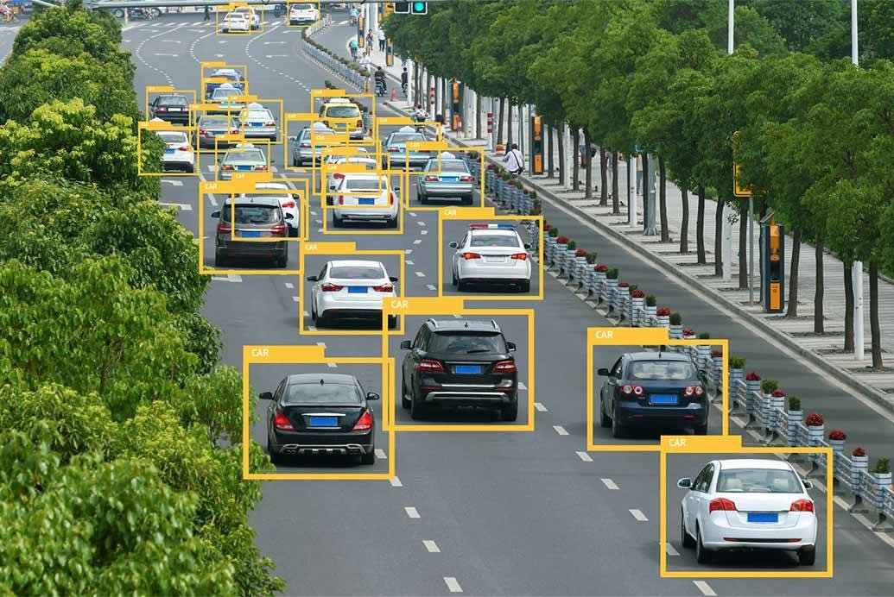
REAL TIME CAR DETECTION
REAL TIME VEHICLE DETECTION
Ankita
Ashwinjeet Singh
Devangi
Rakshit
Sameer
Tushar
By:

Slide 2
Why vehicle detection?
The startling losses both in human lives and finance caused by vehicle accidents.
To check whether the vehicles are parked in parking area or not.
Detecting vehicles in videos or images acquired from a moving platform is a challenging problem.

Slide 3
Before heading forward we need to know some facts
Haar Cascade: digital image features used in recognition, owe their name to their intuitive similarity with haar wavelets
Object detection: process of finding instances of real world objects such as faces, cars etc
Image processing: operations to be performed on image to extract some useful information from it. It’s a type of signal processing in which image is an input.
Working of frames: technique used in computer vision and image processing.

Slide 4
Haar Cascading
A haar cascade is basically a classifier which is used to detect the object for which it has been trained for, from the source.
The haar cascade is trained by superimposing the positive image over a set of negative images. The training is generally done on a server and on various stages. Better results are obtained by using high quality images and increasing the amount of stages for which the classifier is trained.
The algorithm has four stages:
Haar Feature Selection
Creating Integral Images
Adaboost Training
Cascding Classifiers
It is well known for being able to detect faces and body parts in an image, but can be trained to identify almost any object.

Slide 5
Cascade Classifier
The cascade classifier consists of a collection of stages, where each stage is an ensemble of weak learners. The weak learners are simple classifiers called decision stumps. Each stage is trained using a technique called boosting. Boosting provides the ability to train a highly accurate classifier by taking a weighted average of the decisions made by the weak learners.
Each stage of the classifier labels the region defined by the current location of the sliding window as either positive or negative. Positive indicates that an object was found and negative indicates no objects were found. If the label is negative, the classification of this region is complete, and the detector slides the window to the next location. If the label is positive, the classifier passes the region to the next stage. The detector reports an object found at the current window location when the final stage classifies the region as positive.

Slide 6
The stages are designed to reject negative samples as fast as possible. The assumption is that the vast majority of windows do not contain the object of interest. Conversely, true positives are rare and worth taking the time to verify.
-A true positive occurs when a positive sample is correctly classified.
-A false positive occurs when a negative sample is mistakenly classified as positive.
-A false negative occurs when a positive sample is mistakenly classified as negative.
To work well, each stage in the cascade must have a low false negative rate. If a stage incorrectly labels an object as negative, the classification stops, and you cannot correct the mistake. However, each stage can have a high false positive rate. Even if the detector incorrectly labels a nonobject as positive, you can correct the mistake in subsequent stages. Adding more stages reduces the overall false positive rate, but it also reduces the overall true positive rate.
Cascade classifier training requires a set of positive samples and a set of negative images. You must provide a set of positive images with regions of interest specified to be used as positive samples. You can use the Image Labeler to label objects of interest with bounding boxes. The Image Labeler outputs a table to use for positive samples. You also must provide a set of negative images from which the function generates negative samples automatically. To achieve acceptable detector accuracy, set the number of stages, feature type, and other function parameters.

Slide 7
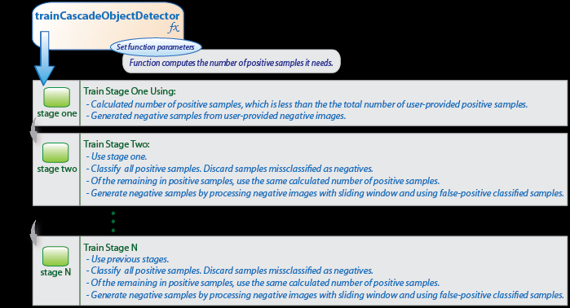

Slide 8
Object Detection
Object detection is a computer vision technique for locating instances of objects in images or videos. Object detection algorithms typically leverage
machine learning to produce meaningful results. When humans look at images or video, we can recognize and locate objects of interest within a matter of moments. The goal of object detection is to replicate this intelligence using a computer.
Object detection is a key technology behind advanced driver assistance systems (ADAS) that enable cars to detect driving lanes or perform pedestrian detection to improve road safety. Object detection is also useful in applications such as video surveillance or image retrieval systems.

Slide 9
Image Processing
Image processing is a method to convert an image into digital form and perform some operations on it, in order to get an enhanced image or to extract some useful information from it.
It is a type of signal dispensation in which input is image like video frame or photograph and output may be image or characteristics associated with that image.
Usually image processing system includes treating images as 2-D signals while applying already set signal processing method to them.
It includes following three steps:
- Importing the image with optical scanner or by digital photography.
- Analysing and manupulating the image which includes data compression and image enhancement and spotting patterns that are not to humanise like sattelite photographs.
- Output is the last stage in which result can be altered image or report i.e. based on image analysis.

Slide 10
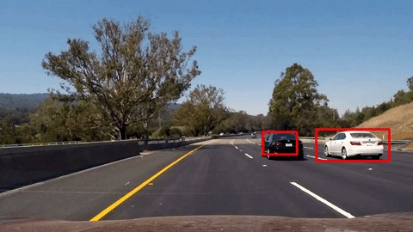
Library used:
OpenCV :
-(Open Source Computer Vision) is a library of programming functions mainly aimed at real-time computer vision. In simple language it is library used for Image Processing. It is mainly used to do all the operation related to Images.
Computer vision is among the hottest fields in any industry right now. It is thriving thanks to the rapid advances in technology and research. But it can be a daunting space for newcomers.

Slide 11
OpenCV has been released under the BSD license and is free for both academic and commercial license. It has C++, Python, C, and Java interfaces and runs on most of the popular operating systems. The library was designed for computational efficiency and with a strong focus on real-time applications. Written in optimized C/C++, the library can take advantage of multi-core processing
Adopted all around the world, OpenCV has more than 47 thousand people of user community and estimated number of downloads exceeding 14 million. The OpenCV library is mentioned here because we will use it later to demonstrate Computer Vision in action working with a Deep Learning Cascade Haar model to solve a real world problem.

Slide 12
The field of computer vision has witnessed continual advancements in the past 5 years. One of the most stated advancement is Convolution Neural Networks (CNNs). Today, deep CNNs form the crux of most sophisticated fancy computer vision application, such as self-driving cars, auto-tagging of friends in our facebook pictures, facial security features, gesture recognition, automatic number plate recognition, etc

Slide 13
Implementation Of The Project
The detection phase of the proposed system is that, mainly
a window of the target size is moved over the input image, and
for each subsection of the image the Haar-like feature is
calculated. This difference is then compared to a learned
threshold that separates non-objects from objects.
The biggest advantage of this method is the calculation
speed. Due to the use of integral images that quickly and
efficiently generates the sum of values in a rectangular subset
of a grid, henceforth a Haar-like feature of any size can be
calculated in constant time.
We converted the RGB images to the Gray Scale images.Like shown in the image below:

Slide 14
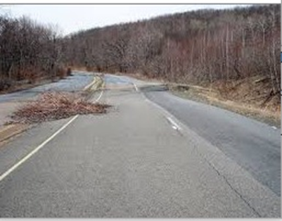
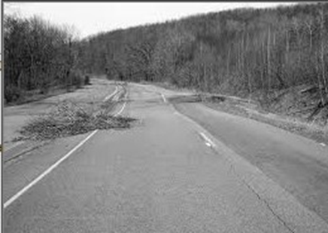
We converted the RGB images to the Gray Scale images.Like shown in the image below:
Next we create the XML files of the various objects (target object) to be detected ie one XML file each for bus, car and twowheeler. The steps involved in creating the XML files is shown below.

Slide 16
Step 1: Collection of Positive and Negative Image Set
For positive and negative images dataset, the images were downloaded from the internet. Then the negative images were made gray-scale. All the negative images are then placed in a folder called negative and all the positive images are then placed in a separate folder.
Step 2: Load the images to the Application Cascade Trainger.
Now we load the positive and negative images into the Cascade trainger.
Step 3: Set the desired Inputs and the tool creates a xml file for the required object.
Set the number of iterations and the tool generates a vector file and a cascade(XML) file that contains the dataset.
Step 4: Loading XML file to OpenCV using cascade Classifier
The generated XML files is then handled with the Cascading Classifiers Command Of OpenCV and then each frame was converted into GrayScale as Coloured frames lower the processing speed. The next step involved detection of objects which was accomplished by the detect MultiScale, the important parameter of this command is the scaling factor which plays an important role in avoiding false detection and miss detection. Various values of scaling factor were tried and the most suitable one was chosen for each of the vehicle detection and hence rectangles were drawn onto the detected objects.

Slide 17
CODE-
import cv2
print('Project Topic : Vehicle Classification/Detection')
print('Machine learning')
cascade_src = 'C:/Users/Rakshit/Desktop/project/cascade.xml'
video_src = 'C:/Users/Rakshit/Desktop/project/video1.avi'
cap = cv2.VideoCapture(video_src)
car_cascade = cv2.CascadeClassifier(cascade_src)
label="CAR"
while True:
ret, img = cap.read()
if (type(img) == type(None)):
break

Slide 18
gray = cv2.cvtColor(img, cv2.COLOR_BGR2GRAY)
cars = car_cascade.detectMultiScale(gray, 1.1, 2)
for (x,y,w,h) in cars:
cv2.rectangle(img,(x,y),(x+w,y+h),(0,255,255),2)
cv2.putText(img,label,(x,y),cv2.FONT_HERSHEY_SIMPLEX,0.6,(255,255,0),lineType=cv2.LINE_AA)
cv2.imshow('video', img)
if cv2.waitKey(20) == 27:
break
cap.release()
cv2.destroyAllWindows()

Slide 19
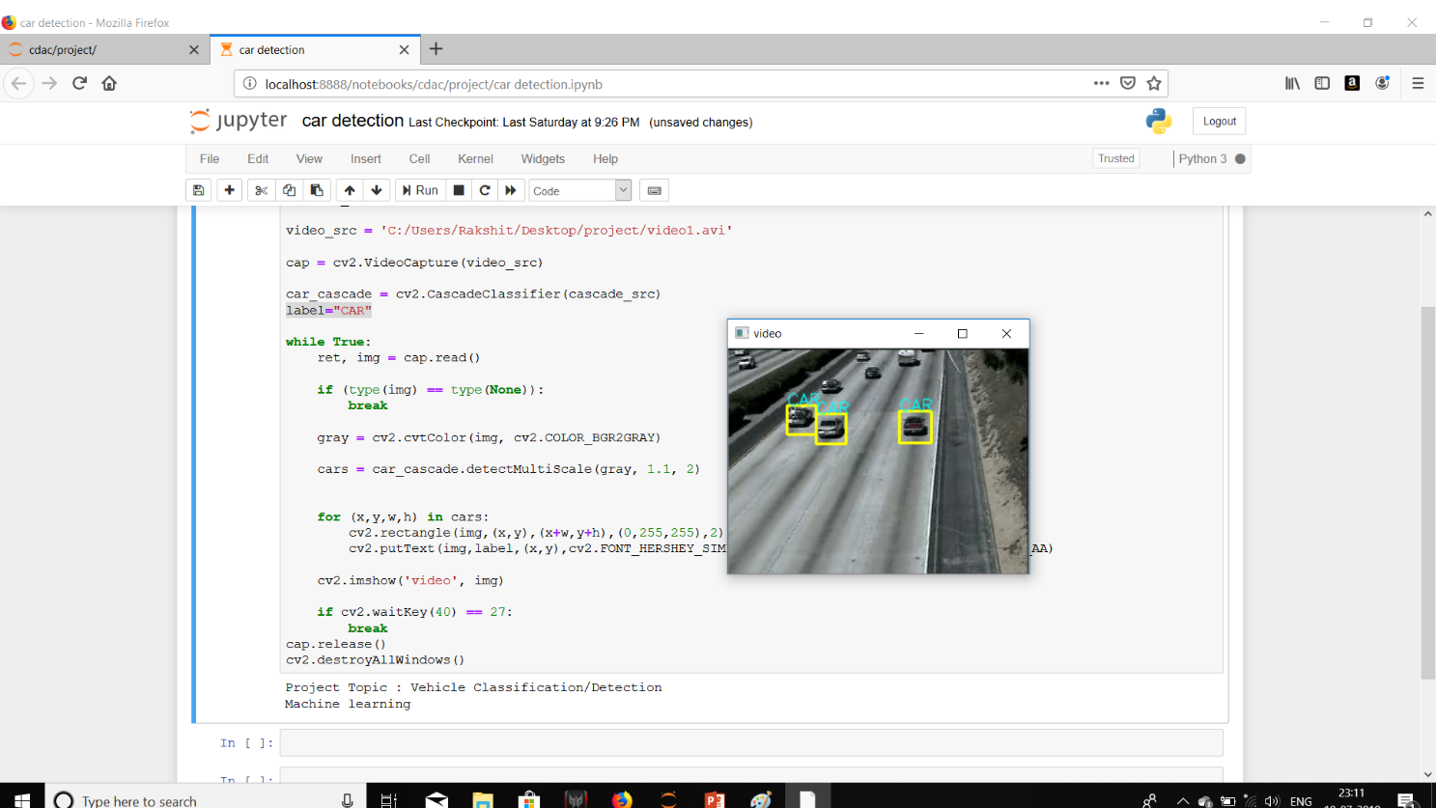
Output-

Slide 20
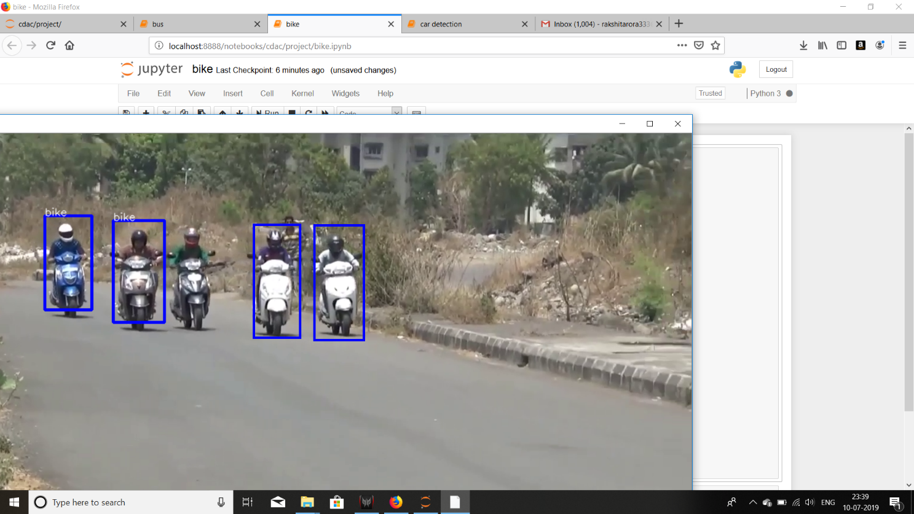
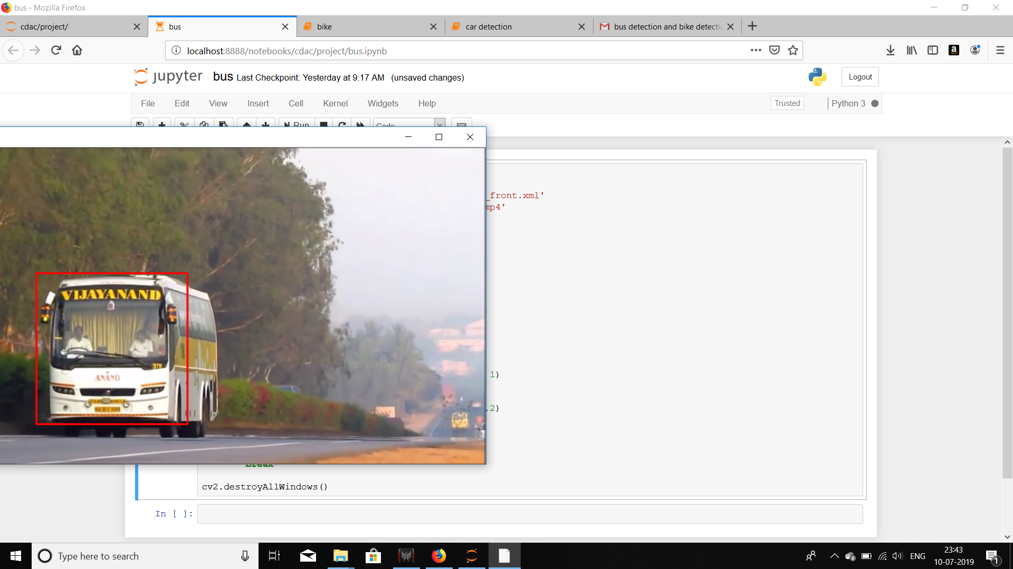
Bike detection Bus detection

